Slide 1
Bridge Pattern
A bridge is a structure built to span a valley, road, body of water, or other physical obstacle, for the purpose of providing passage over the obstacle.

Slide 2
Intent
Decouple an abstraction from its implementation so that the two can vary independently.
Publish interface in an inheritance hierarchy, and bury implementation in its own inheritance hierarchy.
Beyond encapsulation, to insulation.

Slide 3
Bridge and Adapter
The Bridge pattern is used to separate the interface of class from its implementation, so that either can be varied separately.
At first sight, the bridge pattern looks much like the Adapter pattern, in that a class is used to convert one kind of interface to another.
However, the intent of the Adapter pattern is to make one or more classes’ interfaces look the same as that of a particular class.
The Bridge pattern is designed to separate a class’s interface from its implementation, so that you can vary or replace the implementation without changing the client code.

Slide 4
Bridge and Strategy
Often, the Strategy Pattern is confused with the Bridge Pattern.
Even though, these two patterns are similar in structure, they are trying to solve two different design problems.
Strategy is mainly concerned in encapsulating algorithms, whereas Bridge decouples the abstraction from the implementation, to provide different implementation for the same abstraction.

Slide 5
Bridge and Abstract Factory
The Abstract Factory pattern can be used by the Bridge pattern to decide which implementation class to instantiate for an abstraction object.

Slide 6
Motivation
Entry
oracleDBEntry
FilesysEntry

Slide 7
Motivation
Entry
Appointment
Task
OracleDBApp.
FilesysApp.
OracleDBTask
FilesysTask

Slide 8
Motivation
Entry
getText()
setText()
Destroy()
PersistentImp.
initialize()
store()
load()
Destroy()
impl
Bridge
Task
getPriority()
setPriority()
getText()
setText()
Destroy()
Appointment
getAlarm()
setAlarm()
getText()
setText()
Destroy()
OraclePImp
initialize()
store()
load()
destroy()
AccessPImp
initialize()
store()
load()
destroy()

Slide 9
Participants
Abstraction (Entry):
- define the abstraction’s interface
- maintains a reference to an object of type Implementor
Refined Abstraction (Task):
- extends the interface defined by Abstraction

Slide 10
Participants
Implementor (persistentImp):
- defines an interface for implementation
classes. Typically, this Implementor’s
interface provides only primitive method
ConcreteImplementor (oraclePImp, AccessPImp):
- implements the Implementor’s interface

Slide 11
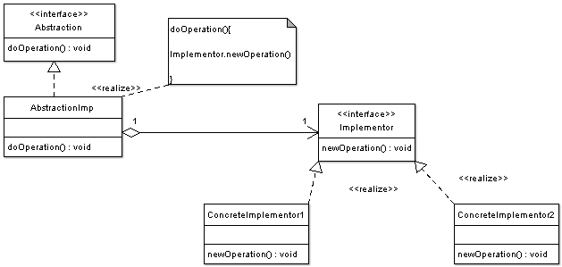
Structure

Slide 12
Participants
Abstraction - Abstraction defines abstraction interface.
AbstractionImpl - Implements the abstraction interface using a reference to an object of type Implementor.
Implementor - Implementor defines the interface for implementation classes. This interface does not need to correspond directly to abstraction Interface and can be very different. Abstraction imp provides an implementation in terms of operations provided by Implementor interface.
ConcreteImplementor1, ConcreteImplementor2 - Implements the Implementor interface.

Slide 13
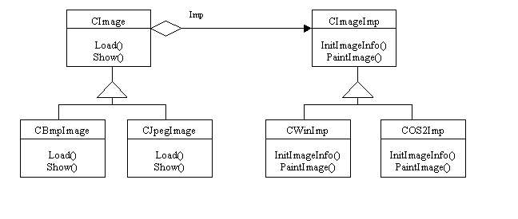
Image viewer application

Slide 14
Benefits in using Bridge Pattern
Decoupling abstraction from implementation
Reduction in the number of sub classes.
Interface and implementation can be varied independently.
Abstraction and implementation can be extended independently.
Loosely coupled client code.

Slide 15
Drawbacks in using Bridge Pattern
Double indirection - In the above example, operating system specific methods are implemented by subclasses of CImageImp class. CImage class must delegate the message to a CImageImp subclass which implements the appropriate method. This will have a slight impact on performance.

Slide 16
Code example
The best example for this is like the electric equipments you have at home and their switches. For e.g., the switch of the fan.
The switch is the interface and the actual implementation is the Running of the fan once its switched-on.
Still, both the switch and the fan are independent of each other. Another switch can be plugged in for the fan and this switch can be connected to light bulb.

Slide 17
Code example
Let’s see how we can convert this into a software program. Switch is the interface having two functions, switchOn() and switchOff().

Slide 18
Switch.java
public interface Switch {
// Two positions of switch.
public void switchOn();
public void switchOff();
}// End of interface

Slide 19
Fan.java
public class Fan implements Switch {
// Two positions of switch.
public void switchOn() {
System.out.println("FAN Switched ON");
}
public void switchOff() {
System.out.println("FAN Switched OFF");
}
}// End of class

Slide 20
Bulb.java
public class Bulb implements Switch {
// Two positions of switch.
public void switchOn() {
System.out.println("BULB Switched ON");
}
public void switchOff() {
System.out.println("BULB Switched OFF");
}
}// End of class

Slide 21
Code example
But, there may arise a case where some other function be added to Switch interface, like change() (change the switch).
In this case, the interface will change and so, the implementations will also change, for such cases, you should use the Switch as abstract class.

Slide 22
If you have a question database, you may want to develop a program to display it based on the user selection.

Slide 23
Question.java
//abstraction
interface Question {
public void nextQuestion();
public void priorQuestion();
public void newQuestion(String q); public void deleteQuestion(String q); public void displayQuestion(); public void displayAllQuestions();
}

Slide 24
QuestionManager.java
//implementation
class QuestionManager {
protected Question questDB; //instantiate it later
public String catalog;
public QuestionManager(String catalog) {
this.catalog = catalog; }
public void next() {
questDB.nextQuestion(); }
public void prior() {
questDB.priorQuestion(); }
public void newOne(String quest) {
questDB.newQuestion(quest); }
public void delete(String quest) {
questDB.deleteQuestion(quest); }
public void display() {
questDB.displayQuestion(); }
public void displayAll() {
System.out.println("Question Catalog: " + catalog); questDB.displayAllQuestions(); }
}

Slide 25
QuestionFormat.java
//further implementation
class QuestionFormat extends QuestionManager {
public QuestionFormat(String catalog) { super(catalog);
}
public void displayAll() { System.out.println("\n~~~~~~~~~~~~~~~~");
super.displayAll(); System.out.println("~~~~~~~~~~~~~~~~~");
}
}

Slide 26
JavaQuestions.java
//decoupled implementation
class JavaQuestions implements Question {
private List<String> questions = new ArrayList<String>(); private int current = 0;
public JavaQuestions() {
questions.add("What is Java? ");
questions.add("What is an interface? ");
questions.add("What is cross-platform? ");
questions.add("What is UFT-8? ");
questions.add("What is abstract? ");
questions.add("What is Thread? ");
questions.add("What is multi-threading? "); }
public void nextQuestion() {
if( current <= questions.size() - 1 )
current++; }

Slide 27
JavaQuestions.java
public void priorQuestion() {
if( current > 0 )
current--; }
public void newQuestion(String quest) { questions.add(quest); }
public void deleteQuestion(String quest) { questions.remove(quest); }
public void displayQuestion() {
System.out.println( questions.get(current) ); } public void displayAllQuestions() {
for (String quest : questions) { System.out.println(quest); } }
}

Slide 28
TestBridge.java
class TestBridge {
public static void main(String[] args) { QuestionFormat questions = new QuestionFormat("Java Language"); questions.questDB = newJavaQuestions();
//can be hooked up with other question class
//questions.questDB = new CsharpQuestions(); //questions.questDB = new CplusplusQuestions(); questions.display();
questions.next();
questions.newOne("What is object? "); questions.newOne("What is reference type?"); questions.displayAll();
}
}

Slide 29
Java Collections class framework
Both the ArrayList and LinkedList concrete classes implement the List interface.
The List interface provides common, abstract concepts, such as the abilities to add to a list and to ask for its size.

Slide 30
Java Collections class framework
The implementation details vary between ArrayList and LinkedList, mostly with respect to when memory is allocated for elements in the list.
Your application can take advantage of this common interface: Wherever you would have a reference variable of either ArrayList or LinkedList type, replace the variable's type with the List interface type

Slide 31
Another example
public class CarTypeAssembler {
public static void assembleCarType(CarType src, CarTypeTO dest) {
dest.setId(src.getId());
dest.setDescription(src.getDescription());
dest.setCarImageUrl(src.getCarImageUrl());
dest.setLuggageCapacity(src.getLuggageCapacity());
dest.setSeatingCapacity(src.getSeatingCapacity());
}

Slide 32
Another example
public static void assembleCarType(List<CarType> src, List<CarTypeTO> dest) {
for (CarType carType : src) {
CarTypeTO carTypeTO = new CarTypeTO();
assembleCarType(carType,carTypeTO);
dest.add(carTypeTO);
}
}
}
The logic in the assembleCarType method
doesn't care if the list of CarType is
implemented as an array or a linked list.

Slide 33
Example III
abstract class Furniture {
FurnitureImp furnitureImp;
public FurnitureImp getInstance() {
return furnitureImp;
}
public void setFurnitureImp() {
this.furnitureImp = FurnitureImpSingleton.getInstance();
}
public abstract void buyFurniture();
}

Slide 34
Example III
class FurnitureImpSingleton {
private static FurnitureImp furnitureImp;
public FurnitureImpSingleton(FurnitureImp furImp){
furnitureImp = furImp;
}
public static FurnitureImp getInstance() {
return furnitureImp;
}
}

Slide 35
Example III
abstract class FurnitureImp {
public abstract void buyFurnitureImp();
}
class TelevisionImp extends FurnitureImp {
TelevisionImp() {}
public void buyFurnitureImp() {
System.out.println("bought Television...");
}
}
class RefrigeratorImp extends FurnitureImp {
RefrigeratorImp() {}
public void buyFurnitureImp() {
System.out.println("bought Refrigerator...");
}
}

Slide 36
Example III
class MoreFurniture extends Furniture {
public MoreFurniture() {
setFurnitureImp();
}
public void buyFurniture() {
FurnitureImp furnitureImp = this.getInstance();
furnitureImp.buyFurnitureImp();
}
}

Slide 37
Client Application
public class BridgePatternExample {
public static void main(String[] args) {
new FurnitureImpSingleton(new TelevisionImp());
MoreFurniture moreFurniture = new MoreFurniture();
moreFurniture.buyFurniture();
}
}

Slide 38
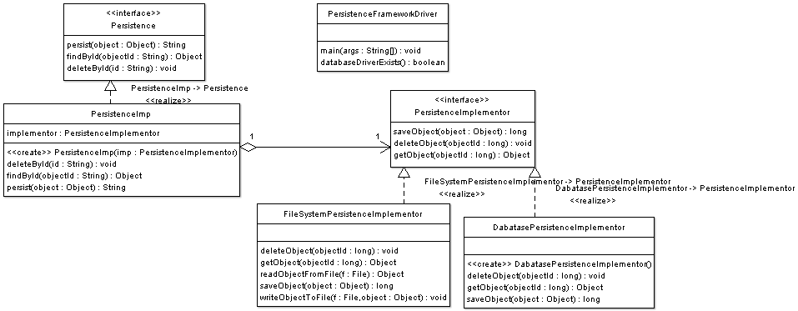

Slide 39
Abstraction interface
public interface Persistence {
public String persist(Object object);
public Object findById(String objectId);
public void deleteById(String id);
}

Slide 40
Abstraction Implementation
public class PersistenceImp implements Persistence {
private PersistenceImplementor implementor = null;
public PersistenceImp(PersistenceImplementor imp) { this.implementor = imp;
}
public void deleteById(String id) { implementor.deleteObject(Long.parseLong(id));
}
public Object findById(String objectId) {
return implementor.getObject(Long.parseLong(objectId)); }
public String persist(Object object) {
return Long.toString(implementor.saveObject(object));
}

Slide 41
Implementor Interface
public interface PersistenceImplementor { public long saveObject(Object object); public void deleteObject(long objectId); public Object getObject(long objectId);
}

Slide 42
Concrete Implementor
public class FileSystemPersistenceImplementor implements PersistenceImplementor{
public long saveObject(Object object) { }
public void deleteObject(long objectId) { }
public Object getObject(long objectId) { }
}

Slide 43
Concrete Implementor
public class DatabasePersistenceImplementor implements PersistenceImplementor{
public long saveObject(Object object) { }
public void deleteObject(long objectId) { }
public Object getObject(long objectId) { }
}

Slide 44
Client
public class PersistenceFrameworkDriver {
public static void main(String[] args) {
PersistenceImplementor implementor = null; if(databaseDriverExists()){
implementor = new DabatasePersistenceImplementor();
}
else {
implementor = new FileSystemPersistenceImplementor();
}

Slide 45
Client
Persistence persistenceAPI = new PersistenceImp(implementor);
Object o = persistenceAPI.findById("12343755"); persistenceAPI.persist(o);
persistenceAPI = new PersistenceImp(new DabatasePersistenceImplementor());
persistenceAPI.deleteById("2323");

